Slide 1
📊
Olist E-Commerce
Sales & Financial Dashboard
Gamal Shaheen
Diploma: Data Analysis
1 June 2026

Slide 2
Project Overview
This project aims to analyze Olist E-Commerce data in order to:
Analyze Olist E-commerce Dataeset
Analyze Sales And Revenue
Analyze payments
Analyze order status performance
Analyze delivery delays
Build an interactive dashboard for decision-making

Slide 3
Dataset Description
Orders Dataset
Payments Dataset
Order Items Dataset
order_id
order_status
order_purchase_timestamp
order_estimated_delivery_date
order_delivered_customer_date
payment_type
payment_value
payment_sequential
price
freight_value

Slide 4
Data Cleaning & Preprocessing
Steps:
Created Columns:
Fixing Data Types
Removing Duplicates
Creating New Analytical Columns
Revenue
price + freight_value
Delay
Delivered Date - Estimated Delivery Date
Order Status Group
Delay Status
Delivered / Pending / Canceled
Used for Late Deliveries
Month
Used for monthly analysis
Payment Accuarcy
Used for Payment Status
Net Profit
price - freight value

Slide 5
Power Query Transformations
1
Importing datasets
2
Cleaning the data
3
Applying Group By on Payments table and order items
4
Merging datasets
5
Creating the Final Table
⚠️ Important: Group By was used to aggregate payments per order and prevent duplication.

Slide 6
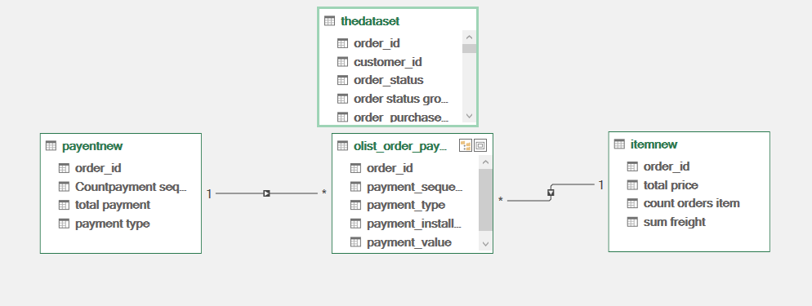
Data Modeling
Relationships were created between tables
Power Pivot was used to create DAX Measures

Slide 7
DAX Measures
Total Revenue
Revenue Reconciliation %
Revenue generated from delivered orders
Comparison between actual and expected revenue
Total Payments Received
Average Delay in Days
Total received payments
Average delivery delay duration
Expected Revenue
Gross Margin %
Expected revenue from approved/non-canceled orders
Profit margin percentage
Average Order Value
Average Order

Slide 8
Dashboard KPIs
💰
💳
📈
⚖️
Total Revenue
Total Payments
Expected Revenue
Revenue Reconciliation %
🛒
🚚
📊
Average Order Value
Average Delay in Days
Gross Margin %

Slide 9
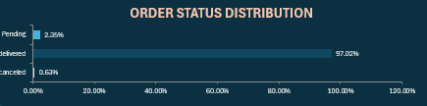
Order Status Analysis
Order statuses were grouped into:
Delivered
Pending
Canceled
Objective: Understand the percentage distribution of completed, pending, and canceled orders.

Slide 10
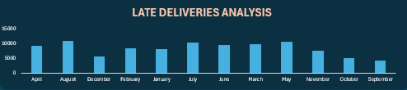
Delivery Delay Analysis
Count of Late Deliveries by Month

Slide 11
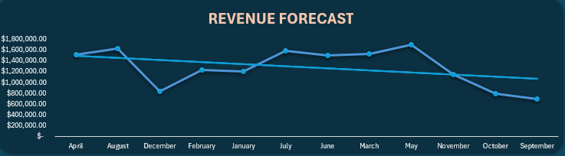
Revenue Forecasting
Monthly revenue trends were used to predict future revenue growth.
Objective: Forecast future sales performance.

Slide 12
Interactive Dashboard Features
Filters Used:
📋 Order Status Group
💳 Payment Type
📅 Date Range
Payment Status

Slide 13
Business Insights
💰
🚚
Most revenue came from delivered orders
Some months showed high delivery delays
⚖️
💳
Actual revenue was close to expected revenue
Credit card payments were the most used payment method

Slide 14
Challenges & Solutions
Challenge
Solution
Duplicate payment records per order
Using Group By to aggregate payments
→

Slide 15
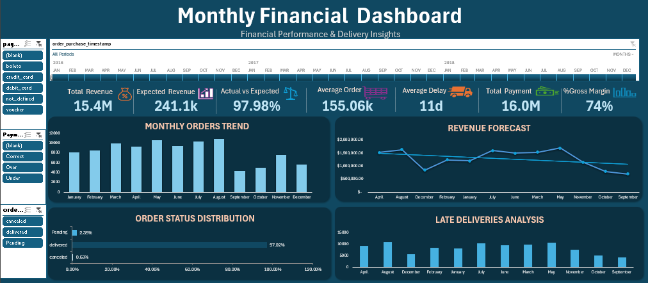
Final Dashboard

Slide 16
Conclusion
This project helped in:
📊 Analyzing sales performance
👥 Understanding customer order behavior
💹 Evaluating financial performance
🖥️ Supporting decision-making through interactive dashboards

Slide 17
📊
Thank You
Questions?
Gamal Shaheen | Data Analysis Diploma

